Slide 1

MYSTORE WEB APPLICATION mini project 1
GARRY M. CACHO, 44yo
An Electrical Engineer by day, and a C++ programmer by night
www.garrymcacho.com

Slide 2
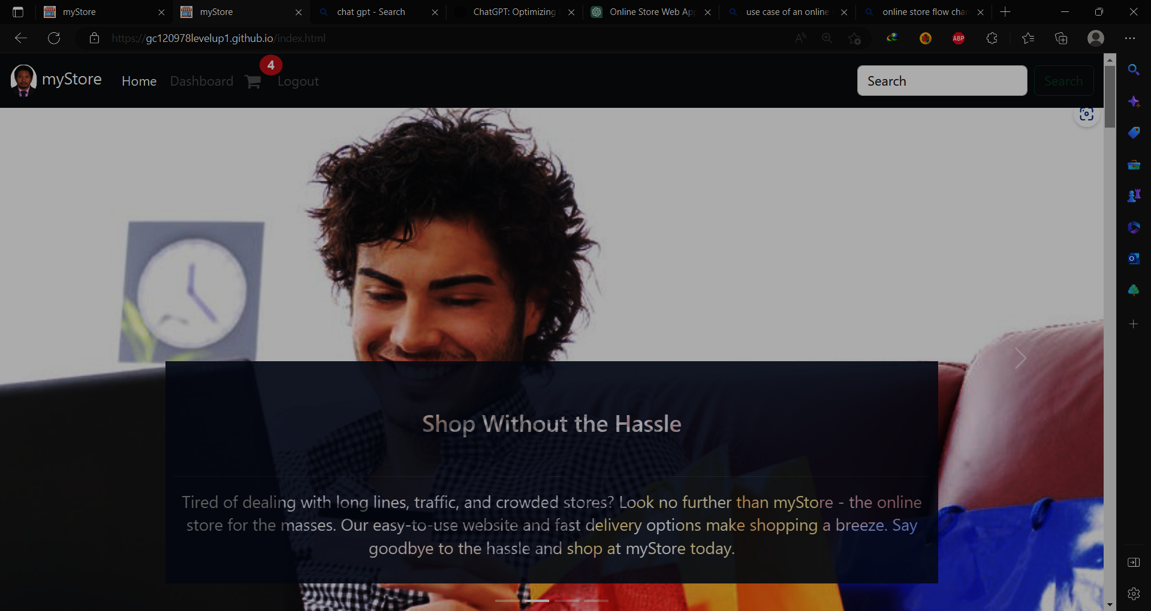
AGENDA
Brief Introduction​
Objectives
Scope and Limitations
Technologies
Use Case
Object Models
Data Flow Diagram
Road Map​
Summary

Slide 3
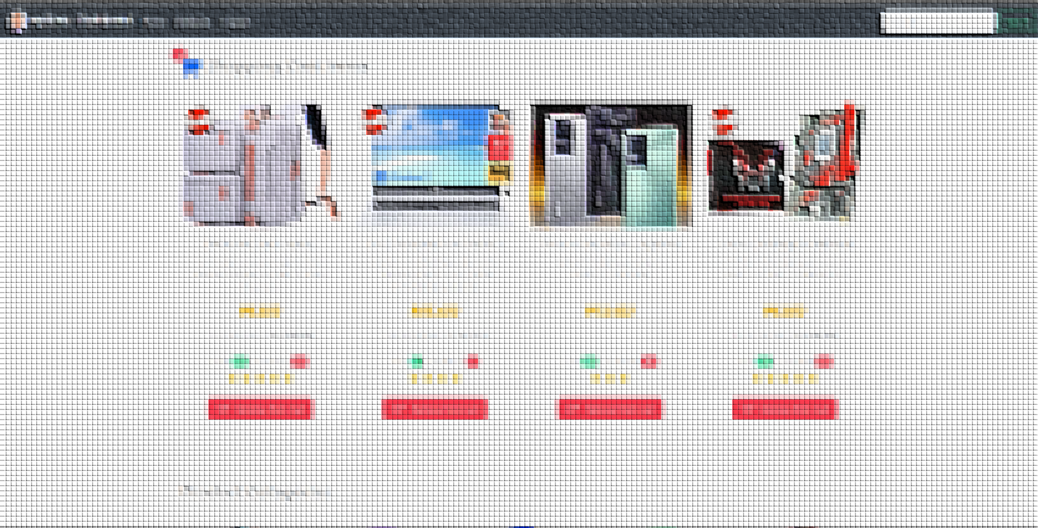
Brief Introduction
Notes:
dgdjfyjryrhette

Slide 4
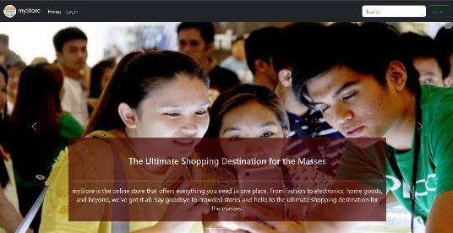
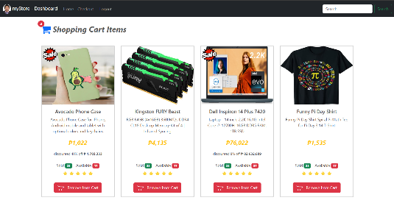
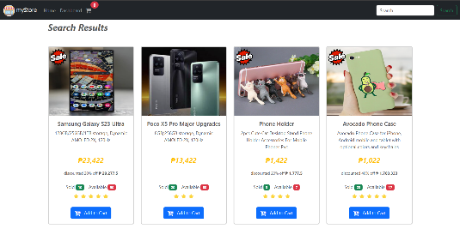
Modern and user-friendly online store web app
Mobile responsive design, accessible from any device.
Advanced product item search and filtering function

Slide 5
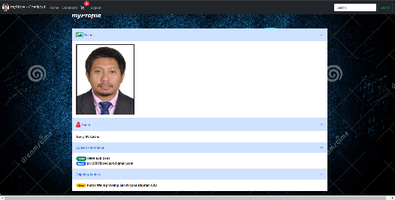
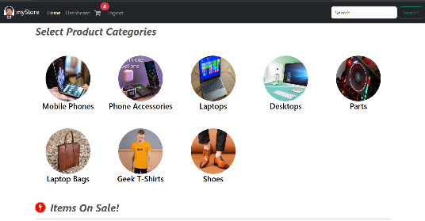
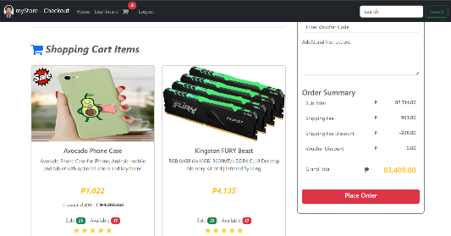
The web app has sign up, login, logout and user info features
Simple product categorization to make the app less cluttery
Clear representation of shopping cart and checkout

Slide 6
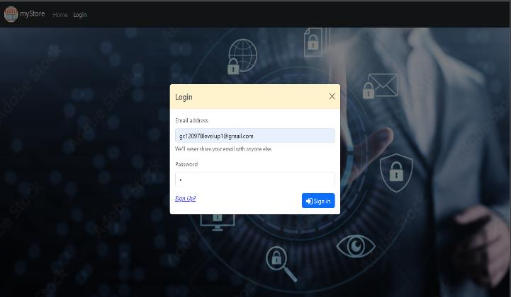
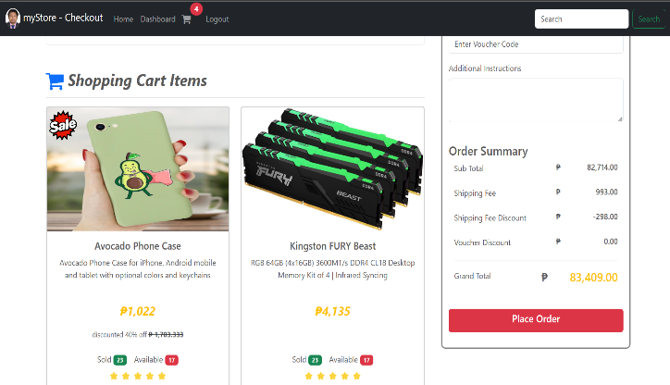
Objectives of the project
To demonstrate our newly learned skills in modern web page design and implementation
To create a proof of concept on how to implement a simple online web app
Notes:
vsdbvsjfbbf

Slide 7
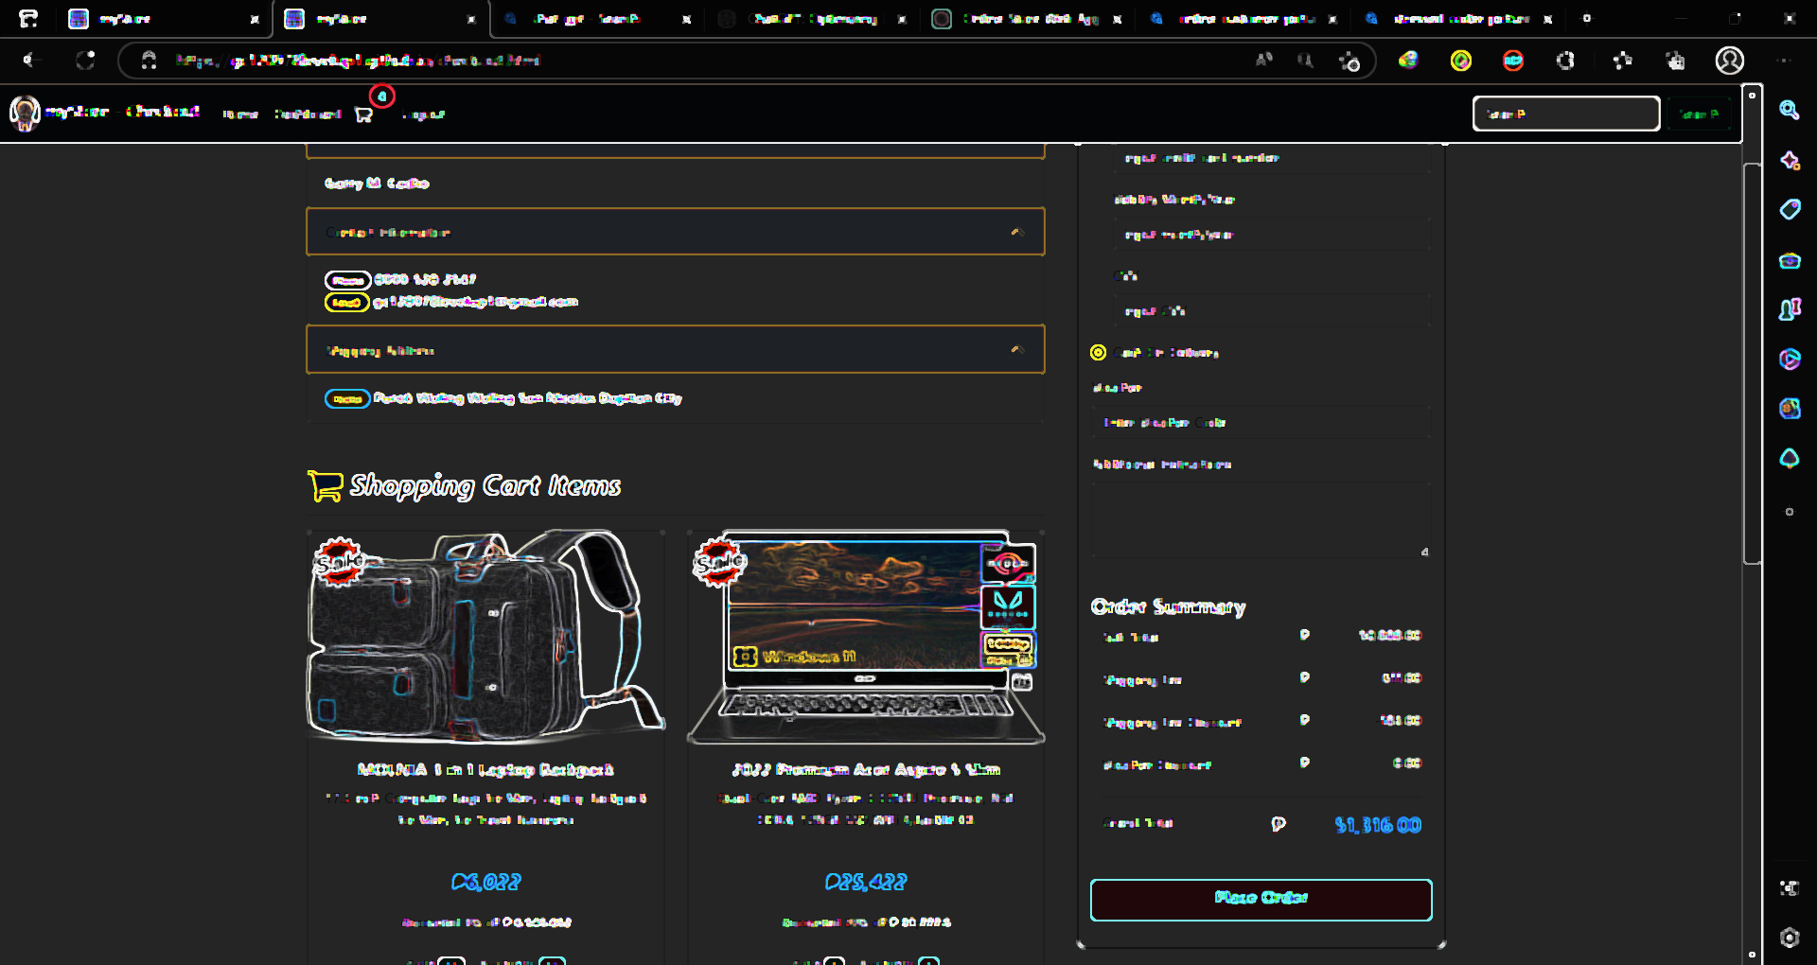
Project scope and limitation

Slide 8

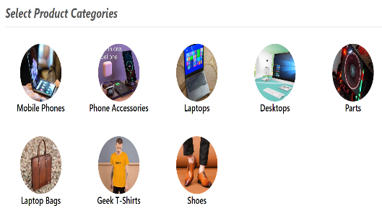

scope
Implementation of a static web application facing the client customer.
Client selection of products categorized initially into 8 groups
Enable the Client to place the product on a shopping cart and perform checkout

Slide 9



limitations
All data used are static therefore user transactions will not be able to permanently save.
Monitoring of status for incoming product deliveries is not implemented
New user Registration form is implemented but not functional

Slide 10

BUSINESS OPPORTUNITIES ARE LIKE BUSES. THERE'S ALWAYS ANOTHER ONE COMING.
Ice breaker
“
”
Richard Branson

Slide 11
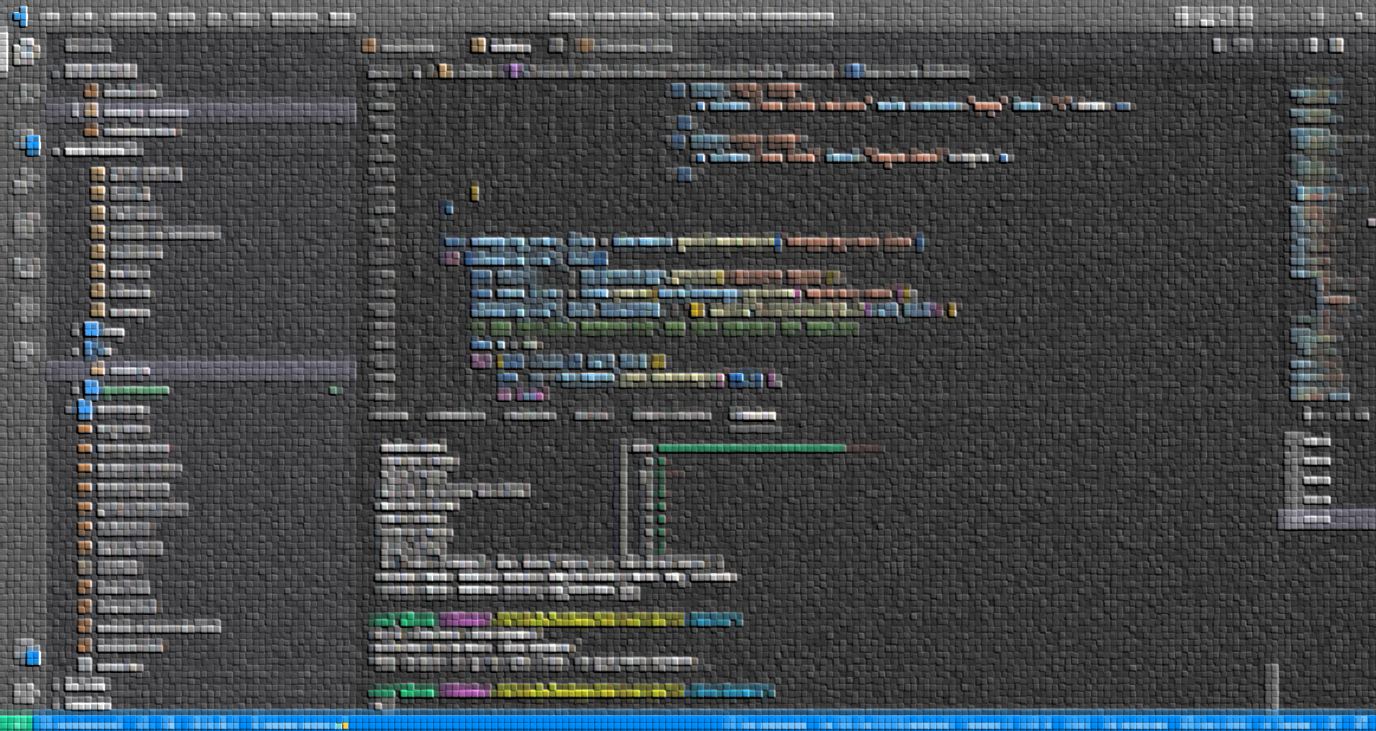
TechnologIES UTILIZED TO IMPLEMENT THE PROJECT

Slide 12





MODEL
JAVASCRIPT OBJECTS
VIEW
HTML, CSS, VANILLA JS, BOOTSTRAP 5
CONTROLLER
VANILLA JAVASCRIPT

Slide 13








IDE
VS CODE w/ HTML-CSS, TABNINE, LIVE SERVER
VERSION CONTROL
GIT AND GITHUB, MINGW-CLI
WEB SERVICE
XAMPP, GITHUB-PAGES

Slide 14
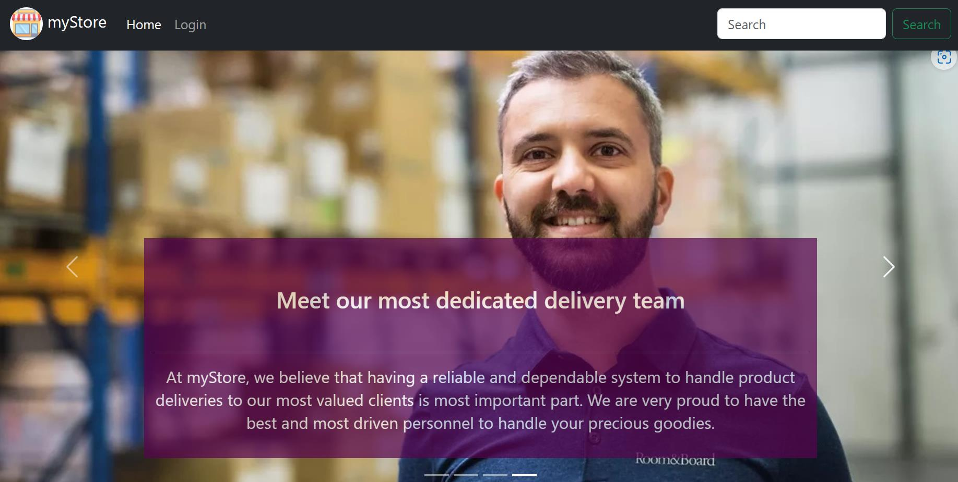
Use case diagram

Slide 15
myStore Online Shopping System
LOGIN
<<include>>
USER INFO
<<include>>
<<include>>
<<include>>
LOGOUT
REGISTERED CUSTOMER
SHOPPING CART
<<include>>
<<include>>
<<include>>
<<include>>
MAKE PURCHASE
<<include>>
CHECKOUT
VIEW PRODUCTS
<<include>>
NON-REGISTERED CUSTOMER

Slide 16
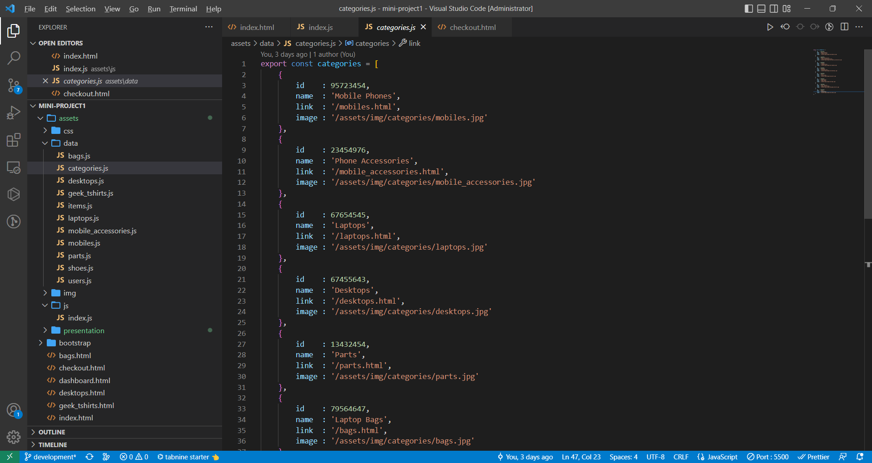
OBJECT MODELS

Slide 17
PRODUCT_CATEGORY
PRODUCT_ITEM
USER
Id : INT
name : STRING
link : STRING
image : STRING
Id : INT
category_id : INT
on_sale : BOOL
description : STRING
specs : STRING
unit_price : NUM
discount_p : NUM
qty : INT
sold : INT
review_rate : INT
main_image : STRING
images : ARRAY{STRING}
email1 : STRING
password1 : STRING
name : STRING
contact : STRING
address : STRING
img : STRING
cart_list : ARRAY{PRODUCT_ITEM}
upcoming_deliveries: ARRAY{PRODUCT_ITEM}

Slide 18


Push mo lang yan te.
Ice breaker
“
“
I CAN’T DO IT, SOOO DARN HARD
-git
-BOOT CAMP GUY

Slide 19
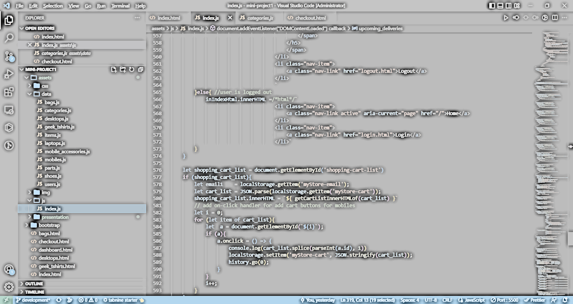
DATA FLOW diagram

Slide 20
CUSTOMER
1.2
1.1
PROD SEARCH
ON SALE LIST
D1
LIST OF PRODUCTS
1.0
HOME
D2
LIST OF CATEGORIES
2.0
6.0
LOGIN
CATEGORY LIST
D3
LIST OF USERS
3.0
DASHBOARD
7.0
SHOPPING CART
D3.1
LIST OF SHOPPING CART ITEMS
4.0
3.1
CHECKOUT
INCOMING SHPM
D3.2
LIST OF INCOMING SHIPMENT
5.0
8.0
PAYMENT
myPROFILE

Slide 21



Road map
backend
Product delivery monitoring
User registrar
Integrate transaction data to a database
Credit card payment integration using STRIPE or PAYPAL
Implement dynamic user registration
Log of product delivery status must be implemented
Dynamic updating of products by the seller

Slide 22
Designing and implementing a simple static online shopping system in spite of yet limited time and experience is challenging but doable and rewarding enough
summary

Slide 23
THANK YOU
Garry M. Cacho
gc120978levelup1@gmail.com
www.garrymcacho.com

